Slide 1
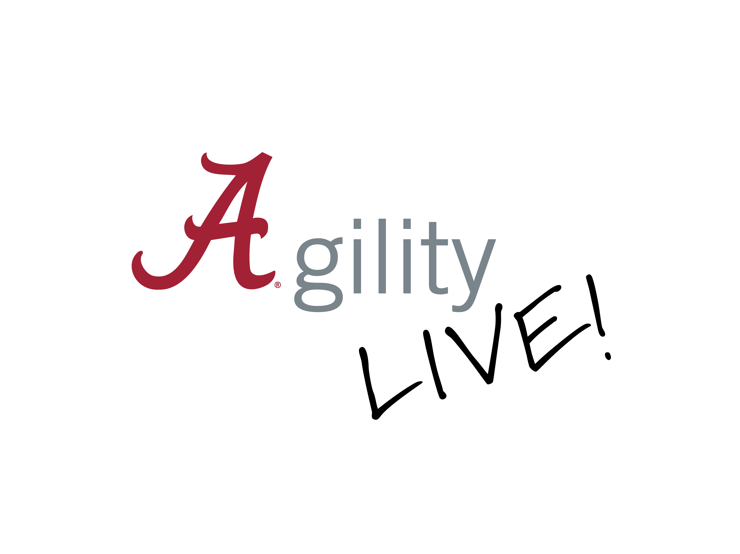
Human Resources
Improved pre-employment appointment processes for new hires, with increased flexibility through virtual appointment options.
Merged several HR newsletters into one unified publication, HR Insider, creating a single, reliable source of HR news.
Introduced the WellBODY program to strengthen employee health evaluations with comprehensive body composition measurements.
Redesigned the Learning & Development website to improve menu clarity, usability, and overall engagement.

Slide 2




Finance & Operations
Shared Administrative Services
Earth Week– We transformed Earth Day into Earth Week and had a week of planned activities for staff centered around Record Retention initiatives and Workplace Efficiency.
Business Mapping to Visio– We converted process narrative workflows to Microsoft Visio for ease of use.
BACPP Verizon Billing – Automatically sends Teams approvals for each org; processing time reduced to 5 minutes compared to half a day.
Closeout Process Reevaluation - Ending these meetings were a time and effort saver for project accountants, project managers, BACPP, construction administration staff, and management.

Slide 3
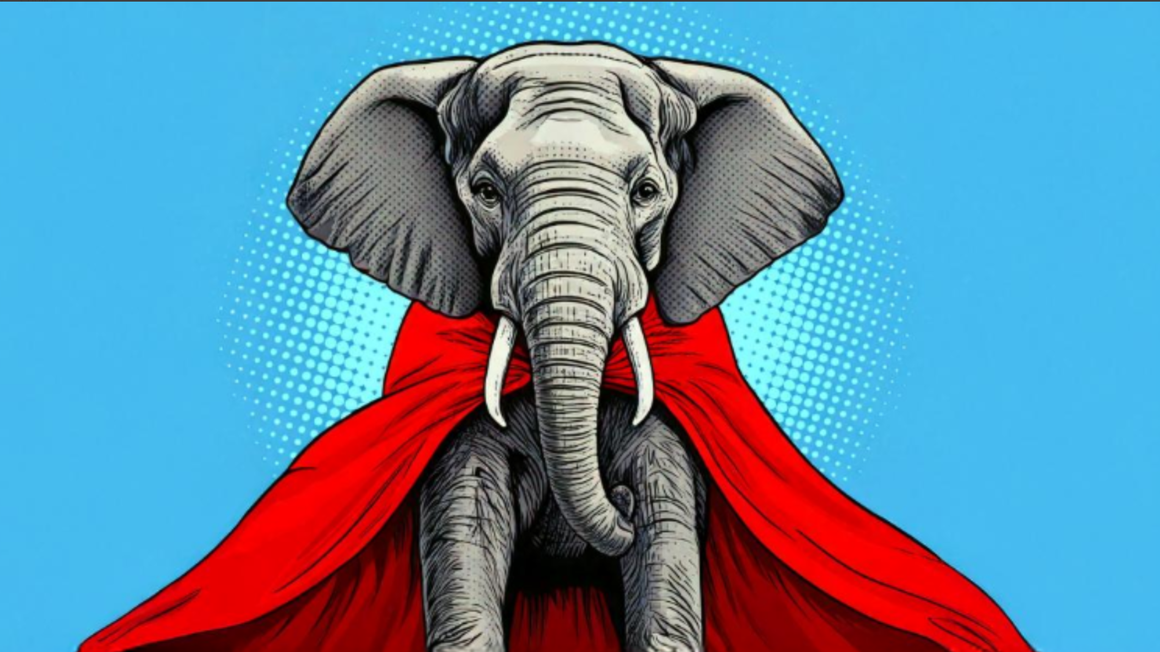

Compliance, Ethics, and Regulatory Affairs
Automated training assignments for Youth Program staff,
simplifying processes for learners.
Updated compliance training processes to ensure courses are
completed in the correct order and improved transparency for learners.
Partnering with Research to implement a new shared
Conflict of Interest Disclosure Platform, removing
redundancy.
Challenged campus to put their ethics knowledge
to work, and helped promote ethics training
provided by other departments.

Slide 4


Risk Management
Simplified and streamlined the driver safety training process, combining 3 coursed into one and automating assignments, reminders, and reporting.
Moved insurance claims into SharePoint to improve collaboration within the office.

Slide 5

Environmental Health & Safety
Standardized processes for reviewing student or departmental project demonstration/testing occurring outside of a traditional laboratory environment.
Redesign of Capstone Village Emergency Operations Plan in collaboration with The Office of Emergency Management and Capstone Village Leadership.
Collaboration with the Student Government Association to produce a high-visibility fire extinguisher training video

Slide 6

Environmental Health & Safety
In Progress
Lab Inspection expansion to meet the demands of
campus & research growth.
Upgrades to the UA Fire Alarm System network.
Outside Vendor Catering Program: Automation of processes and transition from the Office of Risk Management.

Slide 7

Capstone Convergence
UA recently began a two-year project to modernize enterprise systems for Finance, Human Resources, and Research Administration. These systems will be supported by upgraded infrastructure for reporting, identity management, and application integration.
A few highlights:
Watch for a new Single Sign On Portal in May.
A new dual-factor authentication system is coming this fall.
Research and Compliance Conflict of Interest disclosure
processes will be consolidated in September.
Workday will be implemented in February 2028 –
replacing current HR and Finance systems.

Slide 8

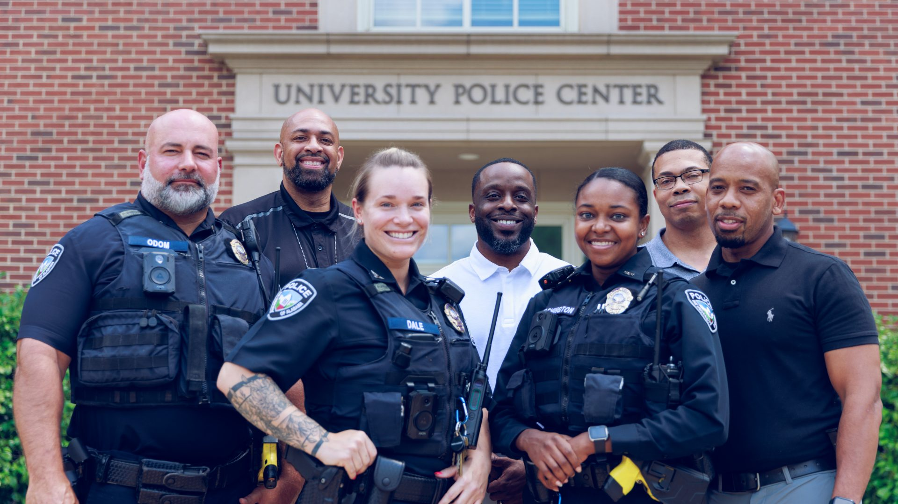
Police and Public Safety
Creation of Real Time Crime Center to enhance campus safety operations
Transition to Cyber Intelligence Focus
Improved Call-Response initiatives

Slide 9
Enterprise Services
Supe Store launched a new website with more customized options for enhanced user experience.
Supe Store expanded the availability and participation for Access Granted. Implemented counter service for in-store textbook purchases.
Printing Services streamlined their online ordering process.
Act Card Services created a Docusign form for online
badge requests.

Slide 10
Bryant Conference Center
Create room templates optimizing new furniture dimensions
BEO batching system to streamline client sets
Change Order & Add-on capture
Create and Asset Lifecycle and "End of Life" tracker

Slide 11
Transportation Services
Transportation Services partnered with SGA, Student Life, and UAPD to launch Look Up Legends! This initiative is a proactive step towards increasing pedestrian safety across campus.
Parking and Campus Event Management implemented virtual permits through OffStreet to streamline campus event parking and maintain zone enforcement.
Transit is advancing the charter reservation process redesign through automation and cross‑functional collaboration with Fleet and OIT to simplify workflows, improve visibility, and enhance the overall reservation experience.

Slide 12
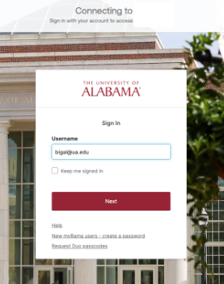
Office of Information Technology (OIT)
Established a Jira Task Force to streamline better usage of JIRA for OIT’s work across campus.
Enabled database encryption with systems on campus to prevent unauthorized access in the event of a breach or loss.
Working on implementing Okta for multi-factor authentication to secure user access across digital identities for seamless collaboration.

Slide 13
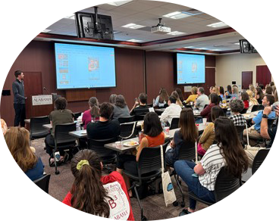
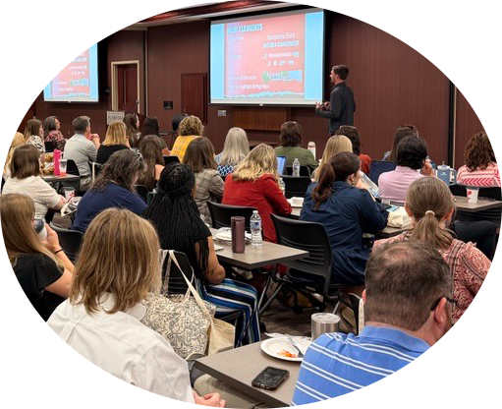
Office of Information Technology (OIT) – Part 2
Guided UA’s academic groups to a next generation LMS with Blackboard Ultra, which provides enhanced accessibility, simplified navigation, and mobile responsiveness.
Hosted “Adobe Day” and “Microsoft Week” on campus in 2025 and 2026 to provide sustained training and engagement for more efficient and effective use by faculty, staff, and students.

Slide 14
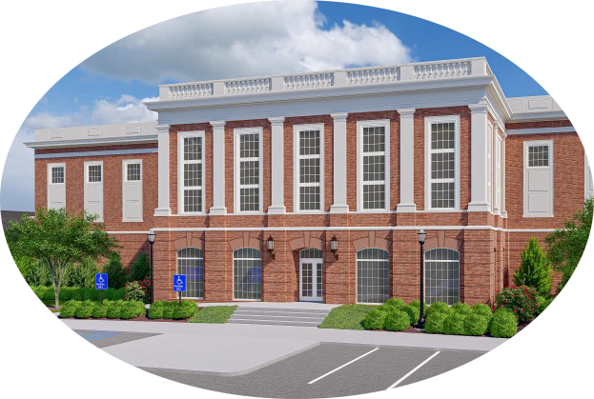

Office of Information Technology (OIT) – Part 3
We are working on our new High-Performance Computing (HPC) Center with an anticipated opening in early 2027. This will allow for a substantial increase in UA’s computing power, increasing competitiveness with grants, but it will also amplify UA’s research enterprise ability to engage in government contracts requiring security compliance.
We’ve been actively engaged in Capstone Convergence as we help implement a new, modern system for Finance and Operations in 2028!

Slide 15
Office of Finance
The Tax Office improved the process for ensuring NRA Tax Compliance by eliminating manual data entry tasks while improving security of sensitive information through new software.
Backpack for Third Party Contract Banner Integration
Developed an automated process for posting non-student bill charges
Updated and automated parts of the K2 Withdrawal Workflow
Independent Contractor Policy Training Initiative developed by Tax Office

Slide 16


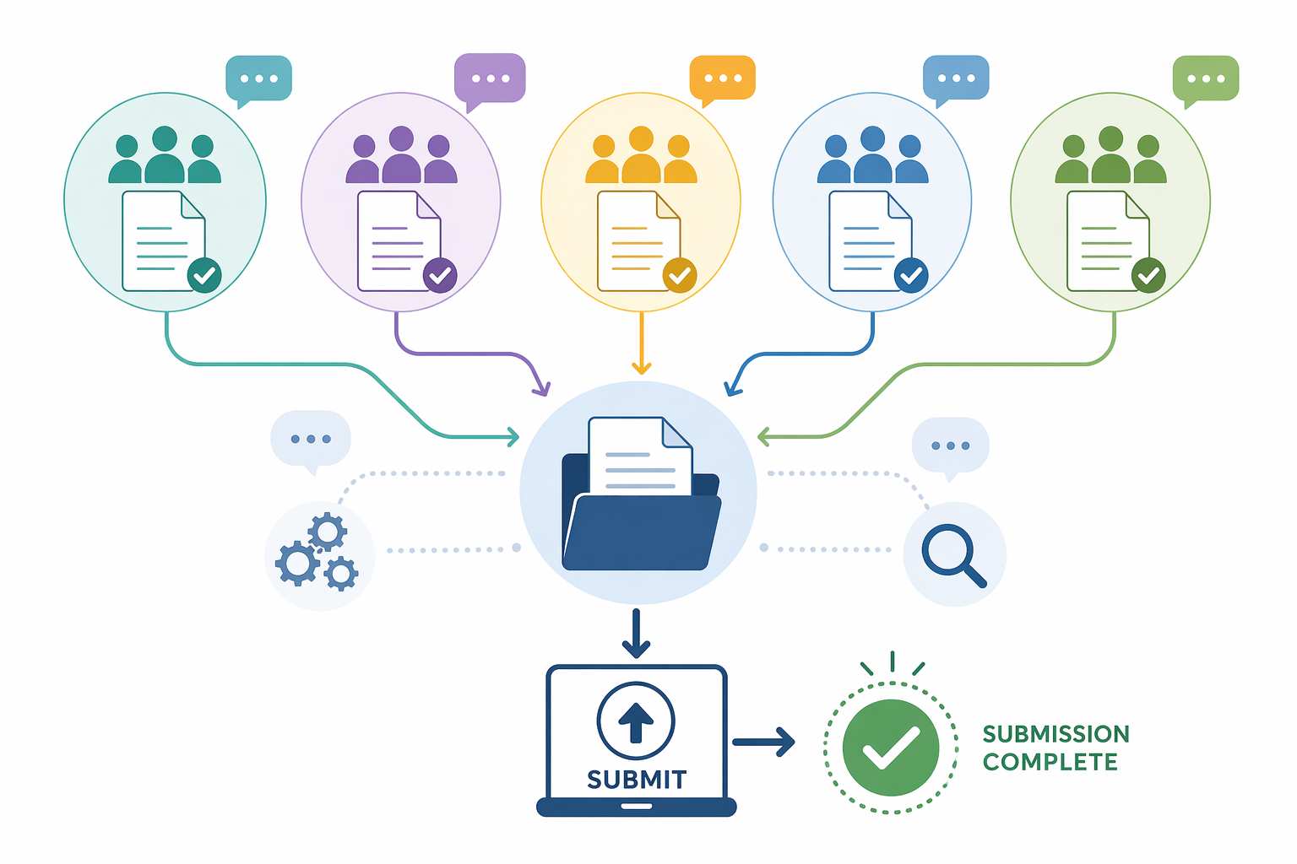
Campus Development
Developing a monthly intuitive form of communication to increase readership and distribution beyond the standard email.
Moving away from MailChimp to Emma. This change will require campus-wide collaboration. It is designed to streamline how departments engage with audiences outside of UA and subscription-based newsletters.
Working with UA System Office and other UAS campuses along with campus partners to improve BOT document submissions.

Slide 17

Office of Academic Affairs
Office of Disability Services
Developed training for on-campus clinical staff to better inform them of their role in the accommodations processes.
In conjunction with Modern Languages & Classics, the core curriculum task force, A&S Student Services, and OAA developed a pre-approved list of substitutions available for students that have a disability-related need to have the World Language requirement waved.
With support from with OAA and Advancement, developed a
hardship fund for students demonstrate financial need and are
unable to produce documentation of disability without support.

Slide 18
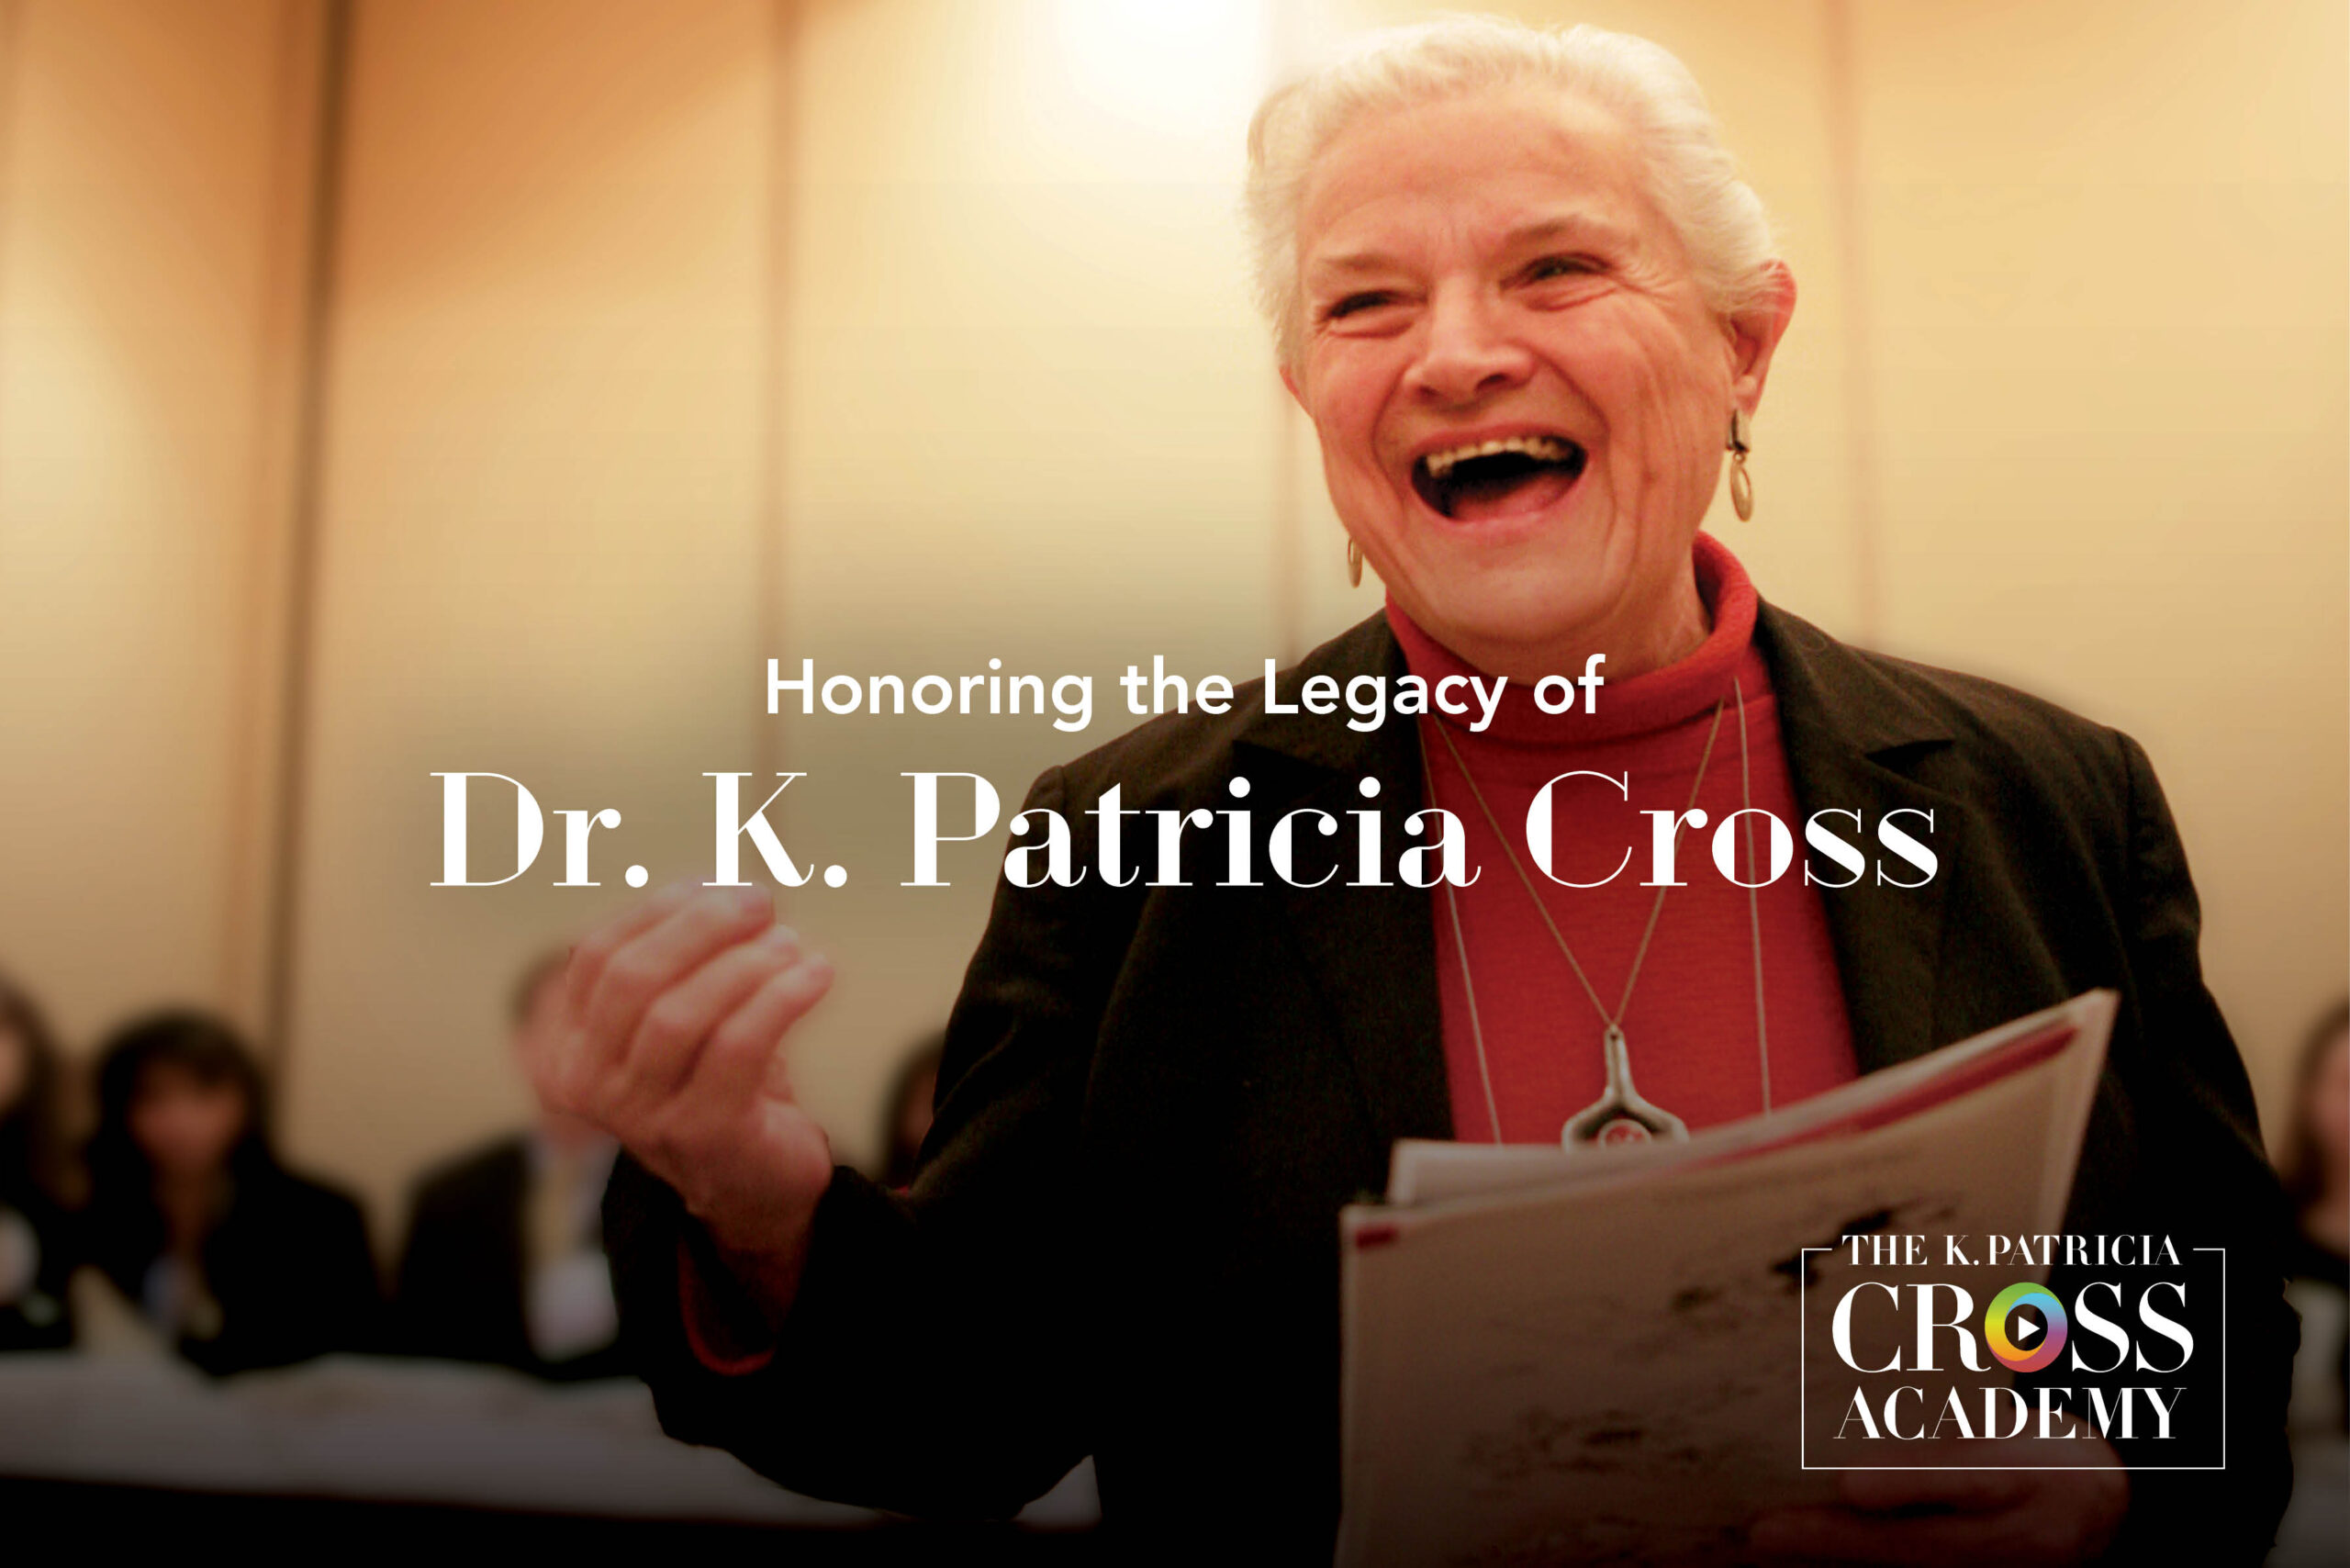
Office of Academic Affairs(2)
OTIDE
Rebranded and expanded UA Online tuition Grants.
Gently reduced cost of early college credits.
Established K Patricia Cross Academy.
Enrollment Management
Developed a new Data Driven Recruitment tool to incorporate new data points and KPIs in the process of student enrollment, retention, and graduation.
Office of Institutional Effectiveness
Obtained SACSCOC accreditation reaffirmation with no
additional report requested.

Slide 19
Honors College
The Honors College joins the University’s Agility Initiative in 2026.
A 12‑member Team formed to advance collaboration and innovation.
Piloted a data system to track students’ experiential learning and research pathways.
Honors Forward’s Strategic Plan metrics integrated into Agility Team action priorities.
Agility Lunch & Learn series coming this Fall.
Building Agility through Honors

Slide 20

Division of Strategic Communications
Launched the Tide Link newsletter, distributed to everyone following UA’s LinkedIn account. (Give us a follow!)
Established new Crisis Comms Plan
Changed recurring meeting and agenda formats using Microsoft Loop
Launched an AI task force user group within DSC

Slide 21
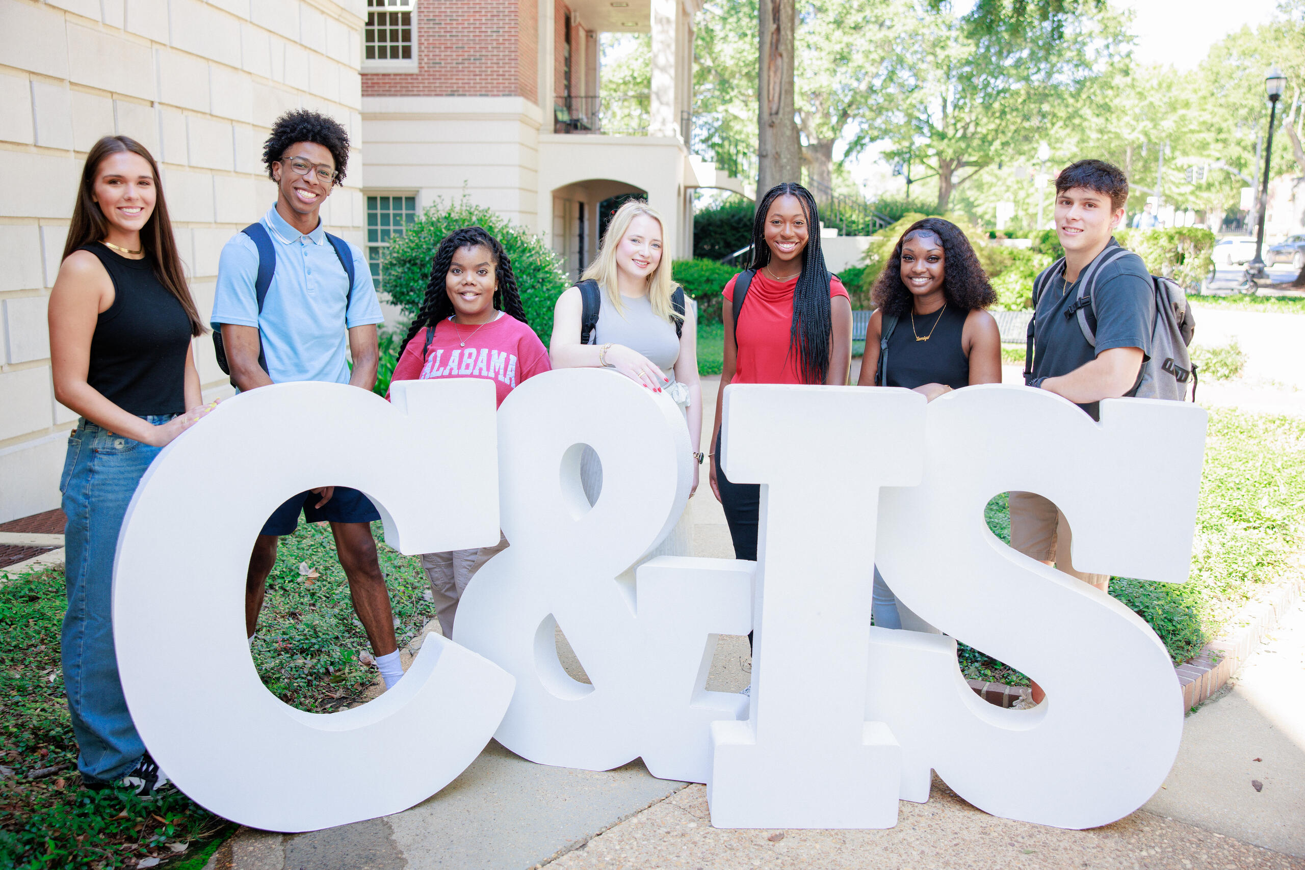
College of Communication & Information Sciences
Updated C&IS mission and vision alongside the creation of a new college Strategic Framework.
Launched new undergraduate major in Informatics as the college’s first Bachelor of Science degree.
Redeveloped C&IS Engagement Portal on a new platform to manage recruitment, selection, and tracking of student engagement opportunities across the college.
Completed programming study for a full renovation and expansion of historical Reese Phifer Hall.

Slide 22
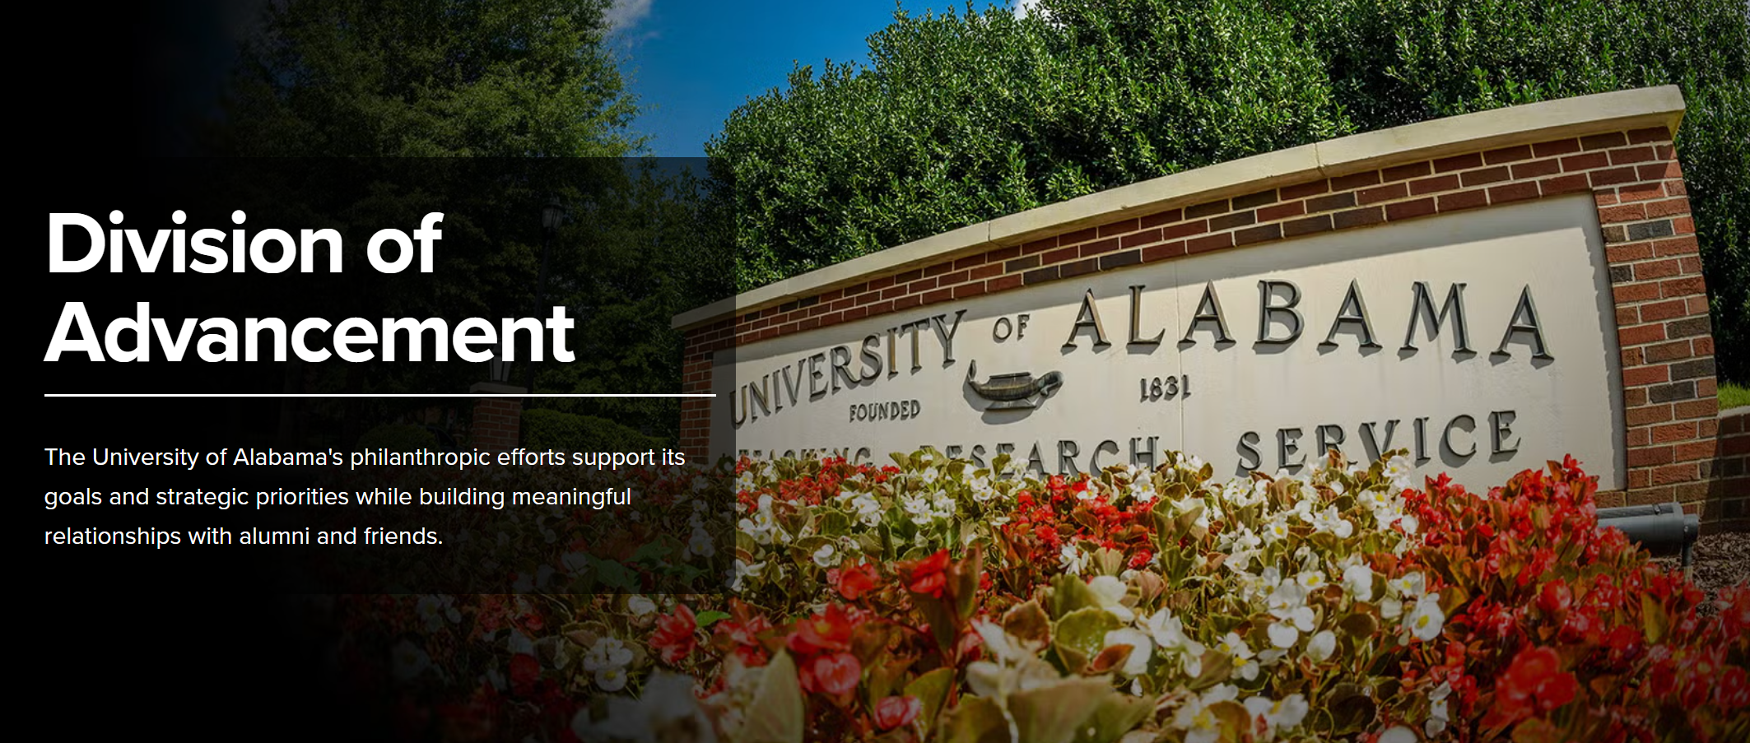
Division of Advancement
Implemented a LinkedIn Advancement page to announce job openings, share successes and career milestones of our employees and promote and publicize philanthropy at UA.
Created a division-wide communications calendar that enhances planning and strategy for communications.
Implemented process efficiency change in Denny to help alleviate the manual review of the Substantial Visit Report by the Prospect Research team. Subcategories were added to reduce time spent to review the report.
Revamped onboarding and implemented a semi-annual, monthly model for Advancement’s six-month onboarding and training program to ensure timely and consistent training of new employees.

Slide 23
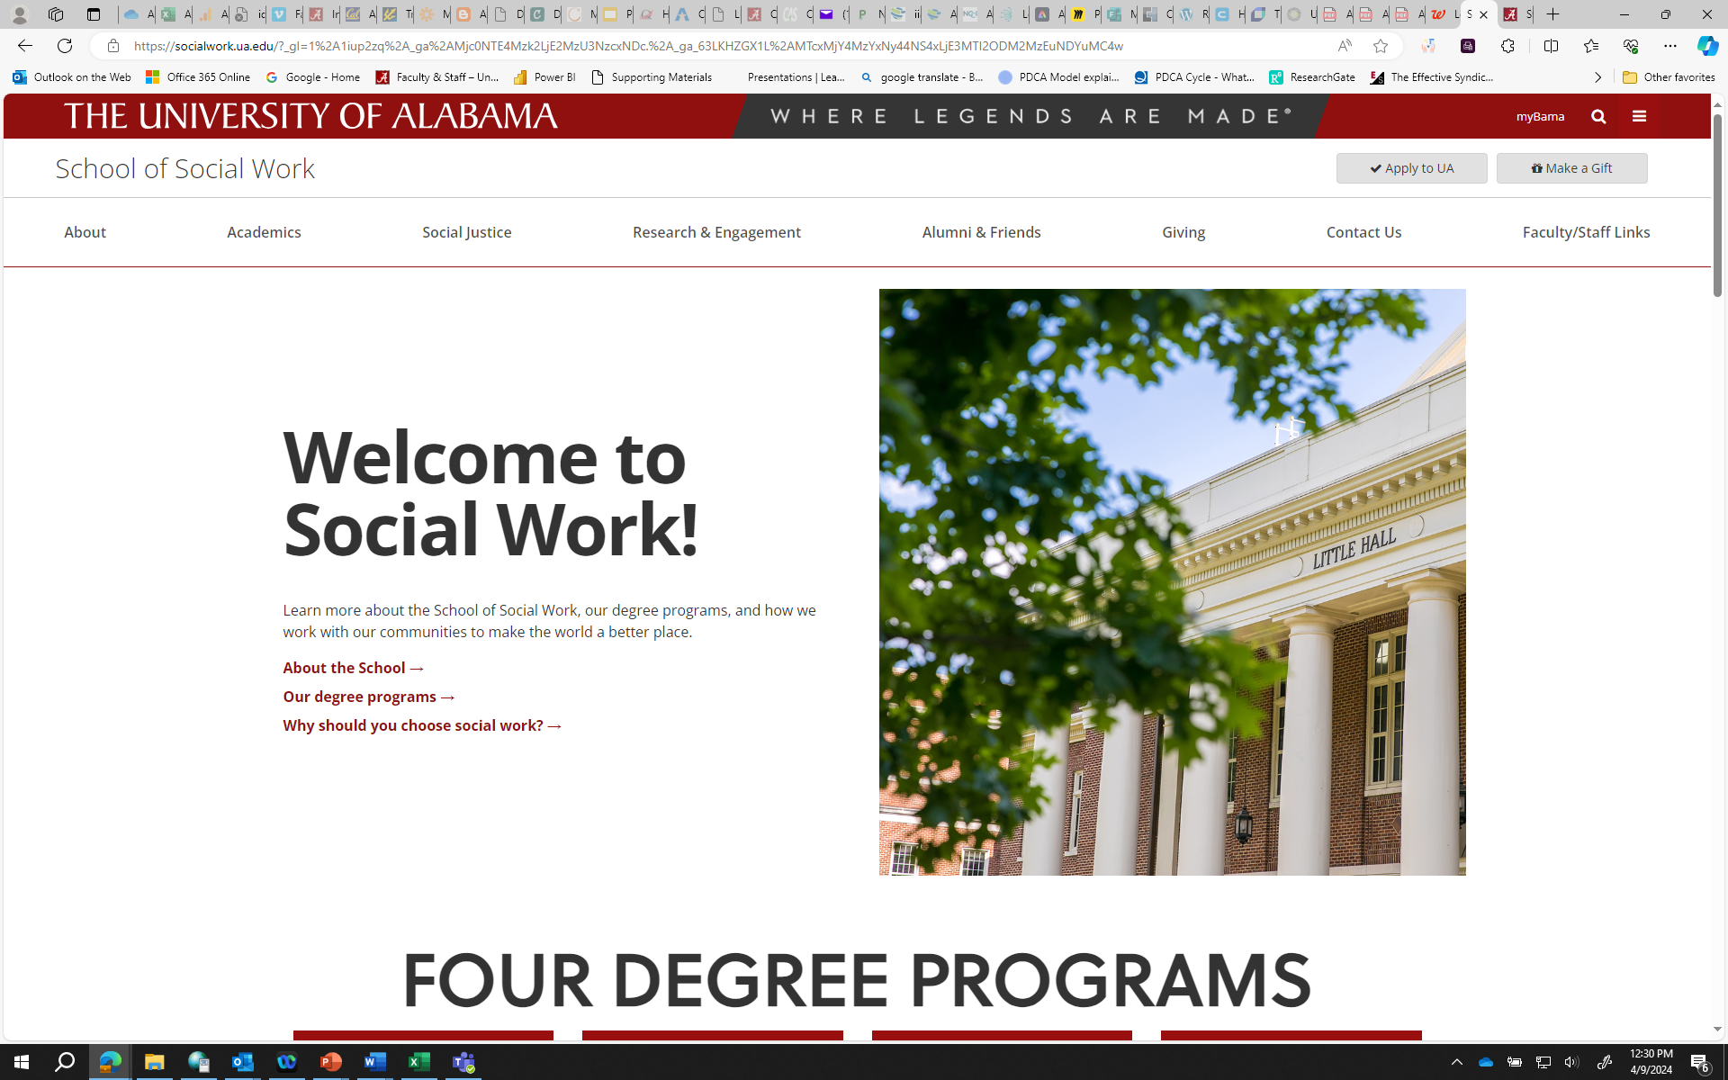
School of Social Work
Digitized School of Social Work funding requests to improve efficiency and transparency
Collaborated with the University Registrar to improve and streamline student enrollment processes
Streamlined advising process to improve accuracy and align with faculty strengths.
Integrated support boards to improve organizational effectiveness and broaden student and community impact

Slide 24
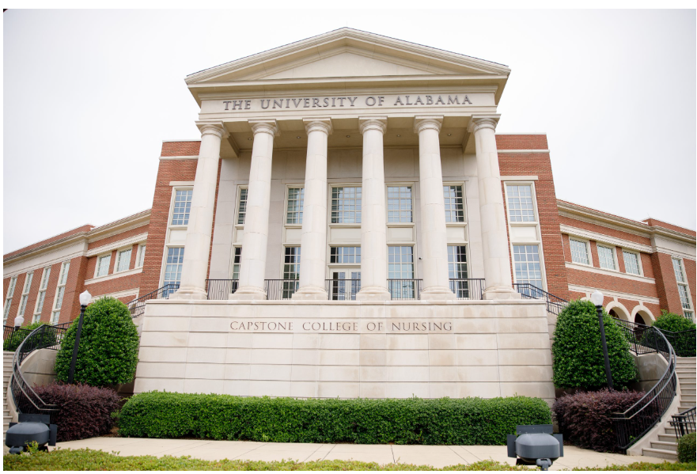
Capstone College of Nursing
CCN-based Agility Series “Lunch and Learn Sessions”
fostered shared learning, cross-role dialogue and
application of Agility concepts to daily work,
Improved pedagogy, scholarship and leadership guided by the Faculty Development Program Model
Refined the faculty/staff orientation process and assignment of mentor based upon new employee feedback

Slide 25
Division of Student Life
Teams Agility Group: Central hub for SL team communication, documentation and division-wide initiative planning.
Monthly Reporting: Online platform for department heads to submit monthly updates on Agility efforts and progress.
Notable Efforts:
Automation & Digitization – Replacing manual workflows with RPA,
Power Automate, SharePoint and digital forms to improve accuracy
and turnaround time.
User Experience & Service Delivery – Streamlining scheduling,
check-in and request processes to improve accessibility
and responsiveness.
Communication & Collaboration – Leveraging Teams and structured communication processes to improve coordination and alignment.

Slide 26
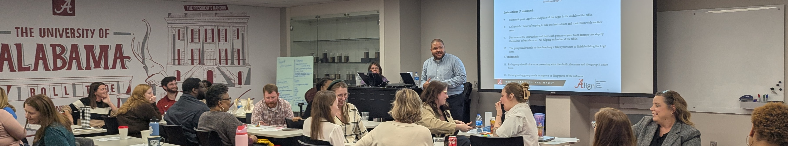
Division for Research
We developed and delivered the Change Makers series to provide timely, informative training to Research Administration personnel, receiving extremely positive participation and feedback. Special Thanks to André, Carolina & Rainey!
We are upgrading the University’s electronic research administration (eRA) systems to a user-friendly platform integrating with other campus systems across the research administration lifecycle.

Slide 27

College of Education
To increase transparency and accessibility, the College of Education created a SharePoint intranet that is password-protected for faculty and staff. This intranet offers college, department, and program information, committee reports, and procedures that are easily accessible.
As a commitment to the College of Education’s wellbeing and health, we requested an embedded counselor through a partnership with the Counseling Center. This counselor will work closely
with students to provide needed assistance.

Slide 28



College of Education(2)
Three of the five departments underwent a self-study analysis for their Annual Program Review (APR). An APR evaluates the impact, effectiveness and efficiencies across the college, department, administration, student services, and student learning.
The assessment team ushered in a new assessment process in AY 2025-2026. This streamlined process offers more meaningful and streamlined data for COE programs to report.
In 2025, the COE implemented revisions that were made to the Renewable Contract Faculty Guidelines. These changes reflected greater alignment with faculty expectations and enhanced clarity and transparency for the promotion process.

Slide 29
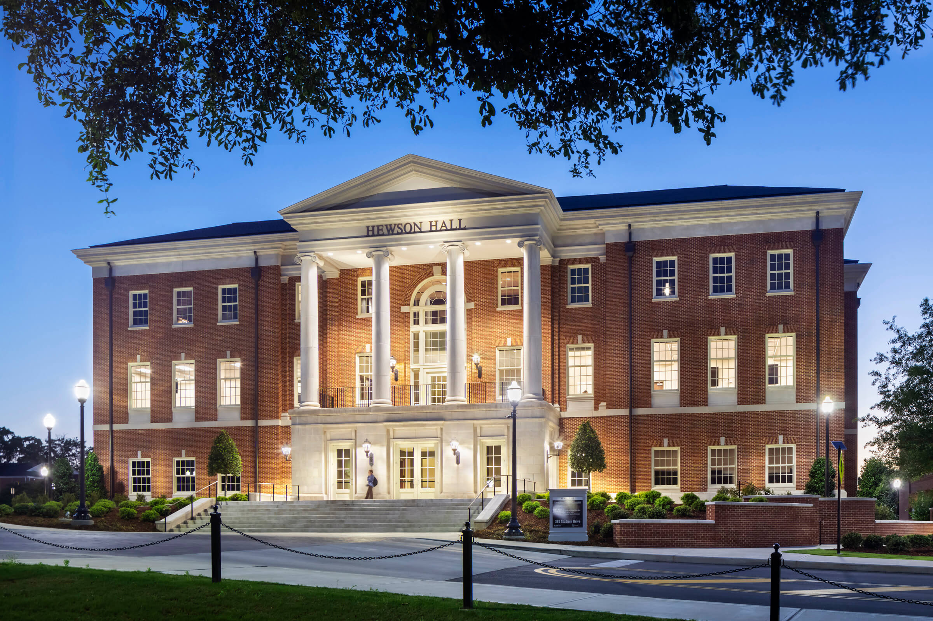
Culverhouse College of Business
A task force examined teaching rigor/grade inflation at the college level and created standardized reports and data visualizations to help faculty understand their relative contributions.
Our PhD task force is in the final steps of consolidating degree programs to ensure long-term viability.
The college is in the middle of a project to revamp how we assess research quality and productivity.
We developed a new college brand-positioning statement.

Slide 30







Engineering
Updating all photos for the Building Directory during the summer, 2026.
Developing a Safety Self-Assessment to build a safety culture throughout the college.
COE Inventory help maintain and track hazardous materials and improve inventory audits.

Slide 31

Graduate School
SLATE Enhancements improved portal for applicants to graduate school and removed manual steps.
GRAD Connection Series was launched to guide admitted and prospective students through their respective processes.
Graduate student position reclassification resulted in better alignment with responsibilities and more detailed reporting.

